Slide 1

INTERNSHIP EVALUATION • MANAGEMENT PRESENTATION • VIVA
Distributor Survey, Retailer Onboarding
& Multi-Brand Analysis
A Study of North Delhi Retail & Distribution Networks
SUBMITTED BY
Neeru
UNIVERSITY / INSTITUTION
University of Delhi
DEPARTMENT
[Department of Operational Research, South Campus
INTERNSHIP DURATION
8 Weeks • 08 Jun 2026 – 02 Aug 2026
SUBMITTED TO
NextG Apex India Pvt. Ltd., Navi Mumbai
Notes:
Good morning / afternoon. Thank you for the opportunity to present my internship work. This project covered an eight-week engagement with NextG Apex India, focused on distributor surveys, retailer onboarding, and multi-brand expansion analysis across four localities of North Delhi. Over the next few minutes I will walk through the methodology, the two Power BI dashboards built, the key findings, and the recommendations that came out of this work.

Slide 2




INTERNSHIP OVERVIEW
SECTION 01 – INTRODUCTION
Programme at a Glance
DURATION
SPONSORING ORGANIZATION
FIELD GEOGRAPHY
FIELD SAMPLE
8 weeks
08 Jun – 02 Aug 2026
NextG Apex India Pvt. Ltd., Navi Mumbai
4 localities,
North Delhi
27 retailers
6 distributors
PROJECT TRACK
Distributor Survey, Retailer Onboarding & Multi-Brand Analysis
Areas Covered: Mukherjee Nagar • GTB Nagar • Gandhi Vihar • Indra Vihar
The internship combined primary field research across retailers and distributors with dashboard-based analysis in Microsoft Power BI, producing a repeatable framework for retailer onboarding and multi-brand expansion.
02
Notes:
This slide sets the scope. The internship ran for eight weeks, sponsored by NextG Apex India, an FMCG distribution and retail company based in Navi Mumbai. Fieldwork was confined to four localities in North Delhi, and the final dataset covered 27 retailers and 6 distributors. The core deliverable was two Power BI dashboards plus a retailer onboarding framework and multi-brand expansion strategy, which I will walk through shortly.

Slide 3
COMPANY PROFILE
SECTION 01 – INTRODUCTION
About the Sponsoring Organization
NextG Apex India Pvt. Ltd.
Navi Mumbai, Maharashtra — FMCG Distribution & Retail
NextG Apex works with a network of distributors and retailers to reach end consumers across urban markets. The organization sponsored this internship to gain a ground-level understanding of how its products and competing brands move through local distribution and retail channels in North Delhi.
Particular | Detail
Nature of Business | FMCG – Distribution & Retail
Year of Establishment | Not available
Head Office | Navi Mumbai, Maharashtra
Product Categories | Breakfast Cereals, Peanut Butter, Rice, Pulses, Beverages & FMCG Products
Market Presence | Maharashtra and other distribution markets
Internship Focus Market | North Delhi micro-market
03
Notes:
NextG Apex India is an FMCG distribution and retail company headquartered in Navi Mumbai. Its product range spans breakfast cereals, peanut butter, rice, pulses, beverages and other FMCG categories. Some organizational details - such as year of establishment and turnover - were not shared as part of the internship brief, so I've left those as explicit placeholders rather than assuming figures. For this internship, the company's primary interest was in evaluating the North Delhi micro-market.

Slide 4



INDUSTRY OVERVIEW
SECTION 01 – INTRODUCTION
The FMCG Distribution Landscape
Indian FMCG products reach consumers through a layered structure. In dense urban markets such as North Delhi, this structure is highly fragmented — a single locality can be served by multiple distributors.
Brand / Company
Distributor
Retailer
Consumer
Kirana Stores
Small Supermarkets
Distributors
Dominant by count — proximity to consumers, flexible credit terms, and fast-moving small-quantity stock.
Fewer in number, but a wider assortment and more organized shelf space.
Profitability driven by retailers served, delivery reach, category mix and retailer relationships — and the primary gatekeepers for onboarding.
04
Notes:
At a high level, products flow from brand to distributor to retailer to consumer. Kirana stores dominate by count because of their proximity to consumers and flexible credit arrangements, while small supermarkets carry a wider assortment. Distributors sit at the center of this chain - their scale and relationships determine how easily new retailers or brands can be introduced into a territory, which is why this study centers on distributor-side data.

Slide 5



PROBLEM STATEMENT
SECTION 02 – FOUNDATION
Why This Study Was Needed
THE GAP
NEED FOR THE STUDY
Before this project, the organization lacked a structured, up-to-date view of retailers and distributors across the four target localities.
Markets Shift Fast
Outlets, brand mix, and distributor capacity change frequently — stale data is unreliable for onboarding.
Which store types & localities have the greatest retailer concentration?
Consistency in Onboarding
Which brands / categories already have strong shelf presence — and which are under-represented?
Without a framework, high-potential outlets get overlooked while poor-fit ones get onboarded.
Which distributors have the scale to support new onboarding or brand lines?
Demand-Led Expansion
Expansion without category-level demand data risks saturated categories or missed opportunity.
What operational challenges do distributors face when onboarding retailers?
Distributor Capacity First
Distributors are the primary channel partner — their operational capacity must be understood first.
05
Notes:
Before this project, NextG Apex had no structured, current view of the retail and distribution landscape in these four localities. Decisions on which retailers to onboard and which brands to push were being made without an objective basis. On the right, you can see why this mattered now: markets shift quickly, onboarding without a framework is inconsistent, expansion without demand data is risky, and distributors - as the gatekeepers - needed to be understood first.

Slide 6



PROJECT OBJECTIVES
SECTION 02 – FOUNDATION
What the Internship Set Out to Achieve
01
02
03
Design & pilot
Collect retailer data
Collect distributor data
A structured survey instrument for both retailers and distributors in the target localities.
Outlet categories, store type, brand & product availability, retail potential, footfall.
Scale, operational capacity, category demand & growth, brand strength, onboarding challenges.
04
05
06
Analyze patterns
Build dashboards
Translate to action
Clean, structure and analyze the data to identify patterns across localities, store types & categories.
Two interactive Power BI dashboards — Retailer Onboarding and Distributor Survey.
Convert findings into a retailer onboarding framework and multi-brand expansion recommendations.
06
Notes:
The internship had six linked objectives: design and pilot a survey instrument, collect structured data from both retailers and distributors, analyze the resulting patterns, build two Power BI dashboards, and finally translate everything into a practical onboarding framework and expansion recommendations. Each of these maps directly to a chapter I'll walk through.

Slide 7


SCOPE OF WORK
SECTION 02 – FOUNDATION
In Scope vs. Out of Scope
IN SCOPE
Structured, in-person surveys of retailers & distributors across all 4 localities
EXPLICITLY OUT OF SCOPE
Mapping outlet categories, store type, brand & product availability, competitor presence
Any collection, estimation, or calculation of distributor financial data — revenue, margins, investment, or ROI.
Mapping distributor scale, delivery capacity, category-level demand & market intelligence
Distributors treated this information as confidential and declined to share it. No attempt has been made anywhere in this report to infer or approximate these figures.
Design of a retailer onboarding workflow based on survey findings
Multi-brand expansion recommendations based on demand & brand-presence data
Development of two Power BI dashboards for retailer- and distributor-side findings
07
Notes:
The scope covered structured field surveys, mapping of outlet and distributor characteristics, and development of the onboarding workflow, expansion recommendations, and both dashboards. One thing was explicitly out of scope from the outset: distributor financial data. Distributors treated revenue, margins and ROI as confidential, and per the agreed scope, no figures were ever estimated or inferred - this is flagged consistently throughout the report.

Slide 8
RESEARCH METHODOLOGY
SECTION 03 – METHODOLOGY
From Survey Design to Full Rollout
1
2
3
4
5
Survey Design
Sampling
Pilot (Week 3)
Full Rollout (Week 4)
Cleaning & Structuring
Two structured questionnaires — retailer & distributor — built from the objectives.
Purposive, area-based sampling across store types & distributor scales.
Piloted in one area to catch ambiguous questions before full rollout.
In-person field visits across all 4 localities via mobile data form.
Standardized store-type & category labels for consistent aggregation.
27
6
4
Purposive
RETAILERS SURVEYED
DISTRIBUTORS SURVEYED
TARGET LOCALITIES
AREA-BASED SAMPLING
08
Notes:
Methodology followed five stages: design two structured questionnaires, define a purposive area-based sample, pilot the survey in one locality during week three to catch ambiguous questions, roll it out fully in week four using an in-person mobile data form, and finally clean and standardize the data for consistent aggregation. This produced a final sample of 27 retailers and 6 distributors across the four localities - a non-probability sample, so findings are read as indicative of these micro-markets rather than statistically representative of the wider city.

Slide 9

RETAIL SURVEY PROCESS
SECTION 03 – METHODOLOGY
What Was Captured at Each Retail Outlet
Store Type Distribution
Locality-wise Coverage
Potential & Footfall
Brand & Product Availability
Kirana stores vs. small supermarkets, by count.
Retailer counts across the four localities.
Retail potential rating + observed customer footfall.
Which brands / categories are stocked, per outlet.
RETAILER DATA FIELDS
Field | Description
Store Type | Category of outlet (e.g., Kirana store, small supermarket)
Location | Area / locality of the outlet
Brand Availability | Brands stocked at the outlet
Product Availability | Product categories stocked at the outlet
Retail Potential | Assessed potential rating of the outlet
Customer Footfall | Observed footfall level at the outlet
09
Notes:
For every retail outlet visited, the survey captured store type, locality, brand and product availability, an assessed retail-potential rating, and observed customer footfall. These six fields feed directly into the Retailer Onboarding Dashboard I'll show shortly - store type and locality drive the coverage view, while potential and footfall drive prioritization.

Slide 10

DISTRIBUTOR SURVEY PROCESS
SECTION 03 – METHODOLOGY
What Was Captured at Each Distributor
Scale & Capacity
Cold Storage
Demand & Growth
Brand Strength
Retailers served, employees, delivery vehicles, area covered.
Availability of cold storage facilities.
Highest-demand and fastest-growing categories.
Strongest brands & preferred expansion categories.
DISTRIBUTOR DATA FIELDS
Field | Description
Retailers Served / Employees / Vehicles | Scale of the distribution operation
Area Covered | Approximate geographical area covered (sq. km)
Cold Storage | Whether cold storage facilities are available
Demand & Growth Categories | Highest-demand and fastest-growing product categories
Strongest Brands / Expansion Potential | Brands with strongest presence; categories with highest expansion potential
Visit Frequency / Business Challenges | How often retailers are visited; major onboarding challenges
10
Notes:
On the distributor side, the questionnaire focused on operational and market-intelligence attributes: scale - retailers served, staff, vehicles, area covered - cold storage availability, category-level demand and growth, brand strength, visit frequency, and the challenges distributors face onboarding new retailers. This data forms the backbone of the Distributor Survey Dashboard.

Slide 11


DATA COLLECTION CHALLENGES
SECTION 03 – METHODOLOGY
Constraints Encountered in the Field
Financial Confidentiality
Self-Reported Fields
Question Ambiguity
Label Standardization
Distributors were unwilling to disclose revenue, margins, investment or ROI — treated as confidential throughout.
Metrics like retailers served, area covered, and category demand were self-reported, not independently verified.
The pilot round in Week 3 surfaced ambiguous wording, corrected before full rollout in Week 4.
Store-type and product-category labels needed standardizing post-pilot for consistent aggregation.
Approach: rather than estimating or working around these gaps, every affected section of the report and dashboards explicitly flags the data as unavailable — no financial figures are inferred anywhere.
11
Notes:
Four constraints shaped the data-collection process. The most significant was distributor unwillingness to share financial information - revenue, margins, investment, ROI - which they treated as confidential. Several distributor-side fields were self-reported rather than independently verified. The pilot round also surfaced ambiguous question wording, and store-type and category labels needed standardizing afterward. Throughout, the approach was to flag these gaps explicitly rather than estimate around them.

Slide 12
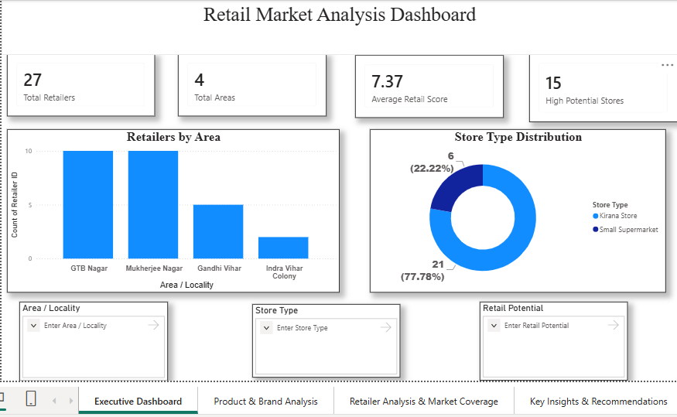
RETAIL DASHBOARD OVERVIEW
SECTION 04 – DASHBOARDS
The Retailer Onboarding Dashboard
Built in Microsoft Power BI, across four pages, filterable by locality, store type and retail potential.
Page | Content
Executive Dashboard | Headline cards + retailer counts by area + store-type split
Product & Brand Analysis | Brand & product-category availability across outlets
Retailer Analysis & Coverage | Locality-wise coverage, brand portfolio, potential
Key Insights & Recommendations | Narrative summary & recommendations
[ Insert Retail Dashboard Screenshot —
Executive Dashboard page ]
12
Notes:
The Retailer Onboarding Dashboard has four pages: Executive Dashboard, Product and Brand Analysis, Retailer Analysis and Market Coverage, and Key Insights and Recommendations. On the right is where the live Executive Dashboard screenshot should be inserted from the Power BI file - it should show the headline cards for total retailers, total areas, average retail score and high-potential stores, plus the retailers-by-area and store-type-distribution charts.

Slide 13

RETAIL DASHBOARD INSIGHTS
SECTION 04 – DASHBOARDS
What the Retailer Data Shows
Market Insights
Product & Brand Insights
Retailer Opportunities
Retail presence observed across multiple localities, helping identify areas of higher retailer concentration.
Multiple national and regional brands identified across surveyed outlets.
Retailers with a wider brand portfolio are natural onboarding priorities.
Kirana stores show strong market presence due to wide availability of fast-moving products.
Availability varies by category — peanut butter, beverages, rice, pulses & breakfast products.
High-footfall Kirana stores offer a route to improved product reach.
DASHBOARD CONCLUSION
The retailer survey provides insight into brand presence, product availability and retailer potential in the North Delhi market — supporting better onboarding decisions, category expansion strategy and improved market coverage.
13
Notes:
These insights are the intern's own reading of the retailer-side data, written directly onto the dashboard's Key Insights and Recommendations page. Retail presence spans multiple localities with Kirana stores dominant; brand and product availability varies meaningfully by category; and retailers with wider brand portfolios, along with high-footfall Kirana stores, stand out as onboarding priorities.

Slide 14
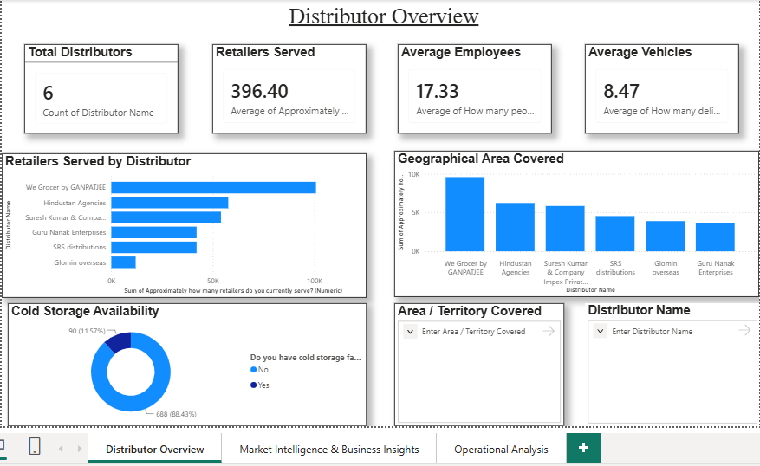
DISTRIBUTOR DASHBOARD OVERVIEW
SECTION 04 – DASHBOARDS
The Distributor Survey Dashboard
Built in Microsoft Power BI, across three pages, filterable by distributor and locality.
Page | Content
Distributor Overview | Headline scale metrics: distributors, retailers served, staff, vehicles
Market Intelligence & Insights | Category demand & growth, brand strength, expansion potential
Operational Analysis | Visit frequency, top distribution / onboarding challenges
[ Insert Distributor Dashboard Screenshot —
Distributor Overview page ]
14
Notes:
The Distributor Survey Dashboard has three pages: Distributor Overview, Market Intelligence and Business Insights, and Operational Analysis. The screenshot placeholder on the right should be filled with the live Distributor Overview page, showing total distributors covered, total retailers served, and average employees and delivery vehicles, alongside the retailers-served-by-distributor and area-covered charts.

Slide 15
DISTRIBUTOR DASHBOARD INSIGHTS
SECTION 04 – DASHBOARDS
What the Distributor Data Shows
Scale Varies Meaningfully
Demand ≠ Growth
Onboarding Friction Points
Cold Storage & Capacity
Distributor scale — retailers served, employees, delivery vehicles, area covered — varies meaningfully across the distributors surveyed.
The highest-demand category is not always the fastest-growing one — a direct input into expansion sequencing.
Onboarding challenges reported by distributors form a practical early-warning list for new-retailer onboarding.
Cold storage availability and delivery reach shape which distributors can realistically absorb new retailers.
These findings feed directly into the Retailer Onboarding Framework (next) and the Multi-Brand Expansion Strategy.
15
Notes:
On the distributor side, four things stand out: scale varies meaningfully across the surveyed distributors; demand and growth are not always aligned for the same category, which matters for sequencing expansion; onboarding challenges reported by existing distributors give a realistic early-warning list; and cold storage and delivery capacity shape which distributors can actually absorb new retailers. These findings feed directly into the onboarding framework I'll cover next.

Slide 16
MAJOR FINDINGS
SECTION 05 – SYNTHESIS
Findings Across the Study
Market
Product & Brand
Retailer Opportunities
Distributor
Retail presence spans multiple North Delhi localities.
Multiple national & regional brands identified.
Wide brand-portfolio retailers = onboarding priority.
Scale varies meaningfully across distributors.
Kirana stores show strong presence via fast-moving products.
Category availability varies — opportunity in under-represented lines.
Small supermarkets & high-footfall Kirana stores stand out.
Demand & growth don't always align — affects expansion sequencing.
16
Notes:
Pulling everything together across four themes: market-level presence, product and brand availability, retailer-side opportunities, and distributor-side scale and demand patterns. Together, these findings are the direct input into the onboarding framework and expansion strategy on the next two slides.

Slide 17
RETAILER ONBOARDING FRAMEWORK
SECTION 06 – RECOMMENDATIONS
A Repeatable, Four-Stage Process
1. Locality & Store Screening
2. Retailer Evaluation
3. Distributor Matching
4. Onboarding & Review
Shortlist areas & store types with highest retailer density and potential.
Assess store type, brand portfolio, product range & footfall.
Match to a distributor with spare operational capacity in the area.
Re-run survey after a review period; compare against baseline.
Stage | Dashboard Support
1. Locality & Store Screening | Executive Dashboard — area / store-type slicers, retail-potential card
2. Retailer Evaluation | Retailer Analysis & Market Coverage — brand portfolio table
3. Distributor Matching | Distributor Overview / Operational Analysis — retailers served, vehicles, area
4. Onboarding & Review | Re-run survey; compare updated dashboard figures against baseline
17
Notes:
The proposed framework has four repeatable stages: screen localities and store types using the Executive Dashboard's filters; evaluate individual retailers on brand portfolio, product range and footfall; match shortlisted retailers to a distributor with spare capacity; and finally onboard and review after a set period, feeding updated data back into the dashboards. The table maps each stage to the exact dashboard view that supports it, so this is meant to be used directly, not just read once.

Slide 18
BUSINESS RECOMMENDATIONS
SECTION 06 – RECOMMENDATIONS
Recommendations & Expansion Strategy
ONBOARDING RECOMMENDATIONS
MULTI-BRAND EXPANSION STRATEGY
Expand the retailer network in areas with higher customer & retailer activity.
Prioritize categories with high demand & expansion potential but low retailer-level availability — unmet demand, not saturation.
Prioritize onboarding of retailers with strong brand availability & product variety.
Treat fastest-growing (but not yet highest-demand) categories as early-stage, test-scale opportunities.
Improve availability of under-represented product categories rather than deepening well-stocked ones.
For strongest-presence brands, focus expansion where they are currently under-represented.
Use distributor-reported onboarding challenges to prepare for common friction points in advance.
Sequence expansion through retailers with a wider existing brand portfolio first.
Revisit these recommendations periodically as new survey rounds are run.
Built on demand, growth & availability signals — not profitability projections, since distributor financial data was not available (see Limitations).
\
18
Notes:
On the left are the onboarding-side recommendations, following directly from the key findings: expand in high-activity areas, prioritize strong-portfolio retailers, and close category gaps rather than over-stocking existing ones. On the right, the multi-brand expansion strategy cross-references product availability, category demand and growth, and brand strength to flag genuine unmet demand versus saturated categories. Because distributor financial data could not be collected, this strategy is deliberately built on demand and availability signals rather than profitability projections — any financial viability check would need to be done separately using the organization's own margin data.

Slide 19
LIMITATIONS
SECTION 07 – REFLECTION
Constraints on These Findings
Financial Data Gap
Sample Coverage
Self-Reported Data
Time Constraints
Qualitative Categorization
Distributors treated revenue, margins, investment and ROI as confidential. No figures have been estimated or inferred anywhere in this report.
Confined to 4 localities and a purposive (non-random) sample — indicative of these micro-markets, not statistically representative of the wider city.
Several distributor-side fields were self-reported rather than independently verified.
8-week duration limited data collection to a single round — a snapshot, not a trend.
"Retail potential" & "customer footfall" used structured but judgment-based ratings, not objectively measured metrics.
19
Notes:
Five limitations are worth flagging honestly. The most significant is the financial data gap — distributors kept revenue and margin figures confidential, and nothing has been estimated in their place. Beyond that: the sample is confined to four localities and is non-random, several distributor fields are self-reported, the eight-week window only allowed a single data-collection round, and potential and footfall ratings are judgment-based rather than objectively measured.

Slide 20

LEARNING OUTCOMES
SECTION 07 – REFLECTION
What This Internship Taught Me
Survey Design
Ground-Level Market Exposure
Data Cleaning & Structuring
Designing a structured instrument — and the value of piloting before full rollout.
Direct exposure to how local FMCG distribution & retail networks are structured.
Hands-on cleaning of field data, standardizing categorical responses for aggregation.
Power BI Dashboarding
Working Within Real Constraints
Business Translation
Multi-page reports, card/bar/column/donut visuals, and cross-filtering slicers.
Handling data limitations honestly — flagging gaps instead of assuming around them.
Turning raw survey findings into an actionable framework & strategy for stakeholders.
20
Notes:
Beyond the deliverables, this internship built six practical skills: structured survey design and the value of piloting; ground-level exposure to how these distribution networks actually work; hands-on data cleaning; Power BI dashboarding across multiple pages and visual types; working honestly within real-world data constraints; and translating raw findings into a business-ready framework and strategy.

Slide 21
CONCLUSION
A Structured, Evidence-Based Starting Point
Eight weeks of field survey, dashboard development, and framework design for NextG Apex India.
Over eight weeks, a structured distributor and retailer survey was designed, piloted and rolled out across four North Delhi localities, and built into two Power BI dashboards covering retailer onboarding and distributor operations.
Subject to the flagged financial-data limitation, this work gives the organization a filterable, evidence-based view that did not previously exist in structured form — and a repeatable starting point for onboarding and expansion in this market.
21
Notes:
To conclude: over eight weeks we designed, piloted and rolled out a structured survey across four North Delhi localities, and turned that into two Power BI dashboards, an onboarding framework, and a multi-brand expansion strategy. Subject to the one flagged limitation on financial data, this gives NextG Apex a repeatable, evidence-based starting point for onboarding and expansion decisions in this market — one that didn't exist in structured form before this internship.

Slide 22

Thank You
Questions & Discussion
SUBMITTED BY
Neeru
PROJECT TRACK
Distributor Survey, Retailer Onboarding & Multi-Brand Analysis
CONTACT
neeru.or.du.27@gmail.com
22
Notes:
Thank you for your time and attention. I'm happy to take any questions — whether on the survey methodology, the dashboard design choices, the onboarding framework, or the expansion strategy.

